Slide 1

CITY FLOW
A Scalable Big Data Framework for Real-Time Analytics in Computing 4.0
¹Priyanshu Mohanty ²Bishnu Prasad Kar ³Mrutunjay Jena ⁴Pragnya Priyadarshini Upadhyaa
Department of Computer Science & Engineering
GIET Ghangapatana, Bhubaneswar
Presented at: 2nd National Conference on Computing 4.0 (NCCENGT-2025) "Empowering the Next Generation of Technology"
Sponsored by: Computer Society of India (CSI)
September 2025

Slide 2
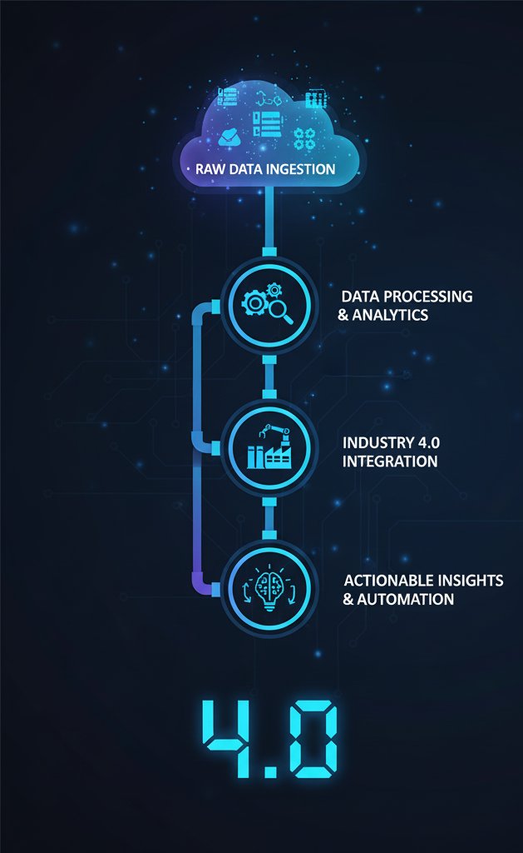
The Computing 4.0 Challenge
Problem Statement
Key Challenges
Exponential growth of urban data in Computing 4.0 era.
Processing millions of records in real-time.
Traditional cloud systems struggle with high-volume, high-velocity workloads.
Handling diverse data types (structured/unstructured).
Smart cities and transportation systems need real-time analytics.
Ensuring fault tolerance and scalability.
Need for scalable architectures for actionable insights.
Integrating ML capabilities for predictive analytics.

Slide 3
Big Data & the Five Vs
Volume
Velocity
Variety
Millions of monthly trip records.
Continuous data generation.
Timestamps, geospatial, fare amounts.
Veracity
Value
Data inconsistencies requiring cleanup.
Insights like demand forecasting.
CityFlow addresses these challenges, enabling scalable and reliable analytics in urban mobility contexts.

Slide 4

NYC TLC Dataset
The NYC TLC dataset contains detailed yellow taxi trip records spanning over a decade, with ~60 million rows and 20+ million trips monthly. Each record includes timestamps, GPS coordinates, trip distances, passenger counts, and fare attributes.
Massive scale and real-time generation
Heterogeneous structure ideal for big data experimentation
Preprocessing addressed missing values and outliers
A visual representation of taxi pickup density across
NYC, highlighting key areas of activity.

Slide 5
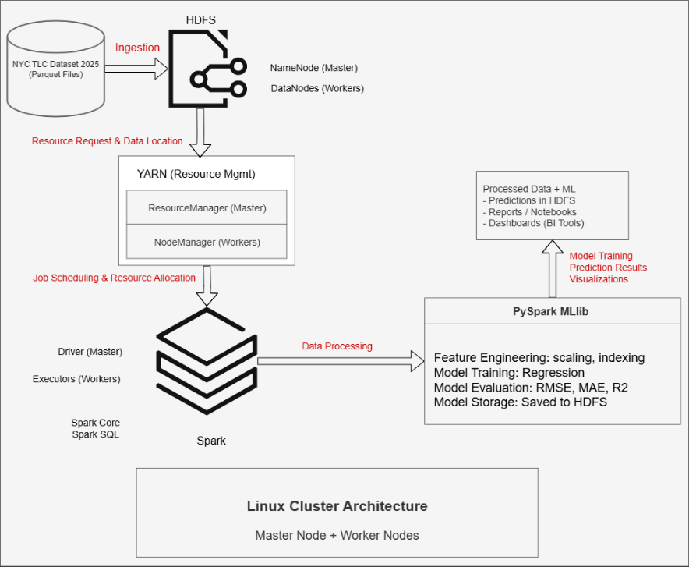
Project Architecture
Distributed Big Data Architecture
Storage: Hadoop HDFS for reliable, scalable data storage
Resource Management: YARN for efficient resource allocation
Processing Engine: Apache Spark as the core engine
Workload Support: Handles batch, iterative, and analytical tasks
Performance: In-memory computations for faster execution
Machine Learning: PySpark MLlib integration for predictive modeling & clustering
Scalability: End-to-end pipeline for large-scale data analytics

Slide 6

Technology Stack
Hadoop & HDFS
Backbone of the distributed architecture
HDFS (Hadoop Distributed File System):
Scalable & fault-tolerant storage system
Replicates data across nodes to ensure reliability
Efficient storage and access for the NYC TLC dataset
Integration with Spark & MLlib:
Provides the foundation for Spark computations
Supplies data for machine learning model training and evaluation

Slide 7

Technology Stack
Apache Spark
Central processing framework in the pipeline
In-memory computation → faster than MapReduce
Spark SQL: Structured queries on taxi records
DataFrames: Easy preprocessing (filtering, aggregation, feature extraction)
Efficiently supports batch, streaming, and iterative tasks
Provides foundation for MLlib machine learning workflows

Slide 8

Technology Stack
PySpark MLlib
Spark’s Machine Learning library
Scalable algorithms for:
Regression
Classification
Clustering
Used for predictive modeling:
Trip demand forecasting
Fare estimation
Evaluated with metrics like Accuracy and RMSE
Tight Spark integration → high performance & flexibility

Slide 9

Technology Stack
YARN (Yet Another Resource Manager)
Core resource manager in the Hadoop ecosystem
Handles resource allocation across cluster nodes
Manages job scheduling for optimal utilization
Ensures multi-user and multi-application support
Acts as the link between HDFS storage and Spark processing

Slide 10
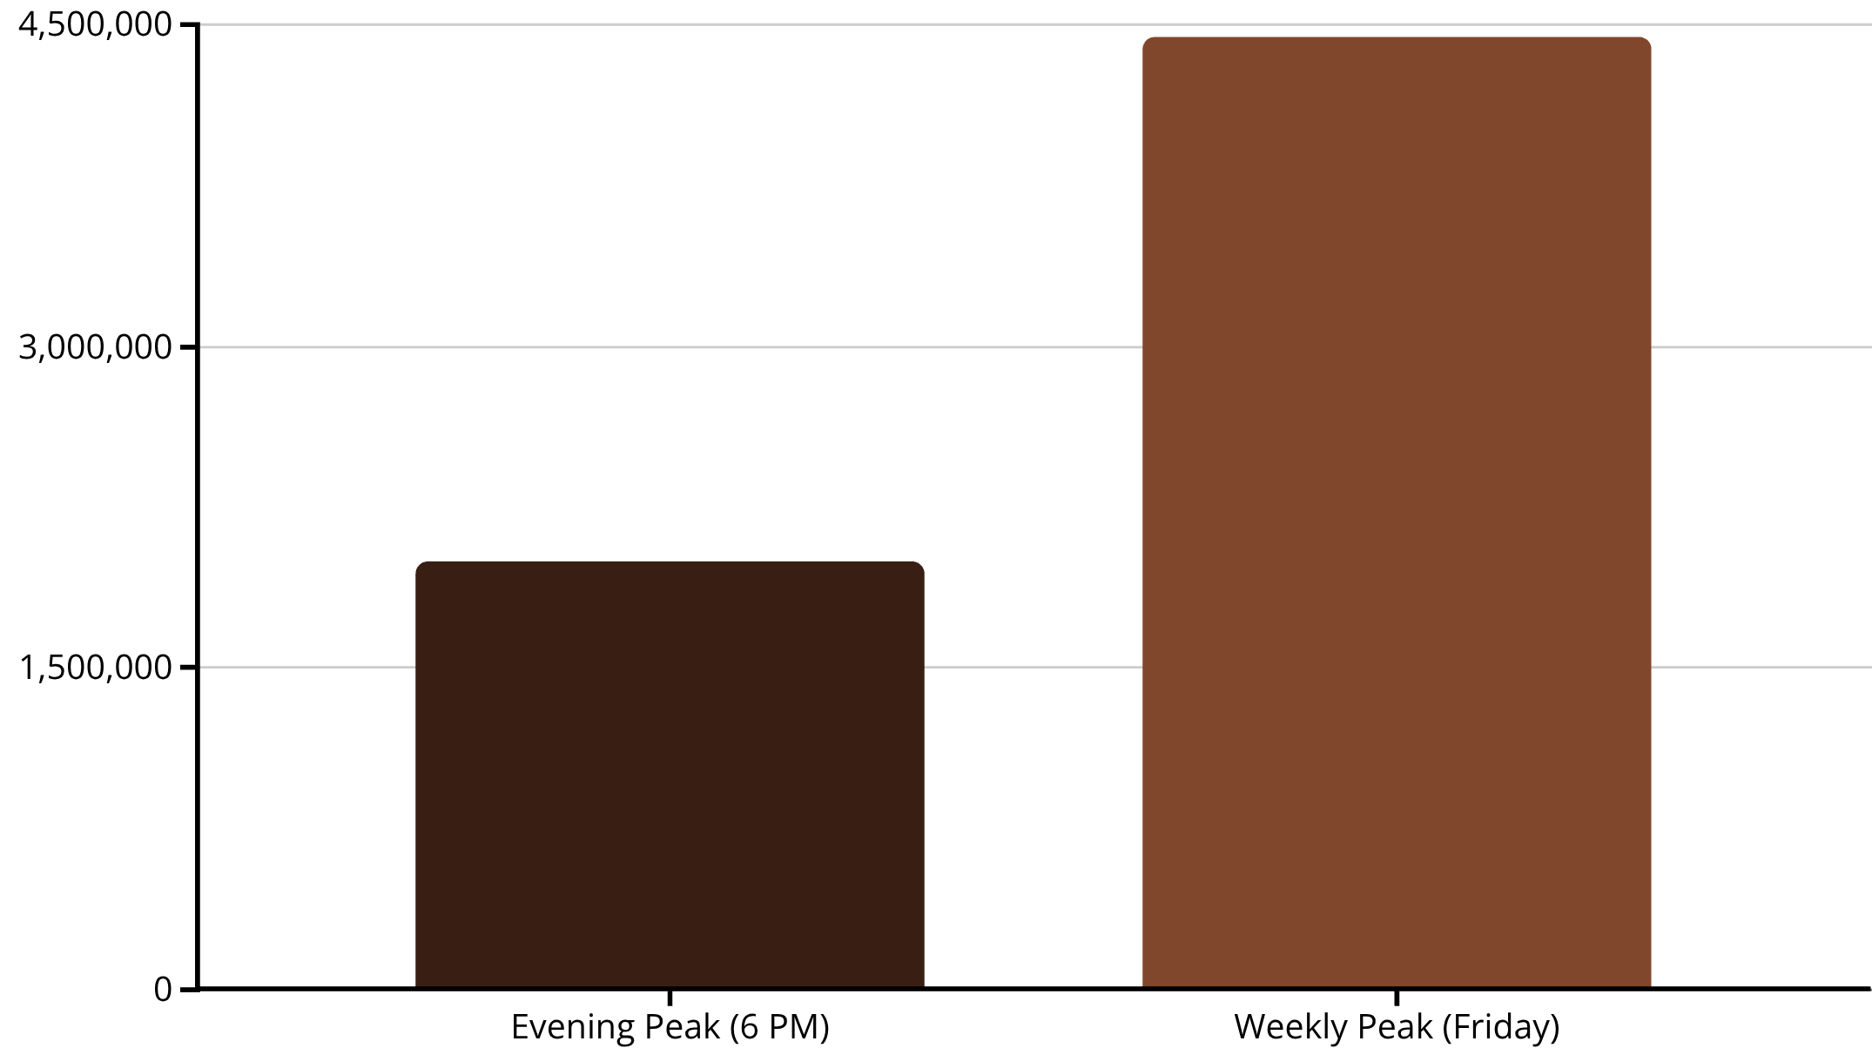
Implementation & Exploratory Data Analysis
Preprocessing Steps
Exploratory Data Analysis (EDA)
Data Ingestion
From NYC TLC sources.
Missing Value Imputation
Outlier Detection & Removal
Feature Extraction & Engineering
Data Validation & Quality Checks
Processing Capabilities
Batch processing for historical analysis.
Average Trip Distance: 7.06 miles Average Fare: $17.98
Stream processing for real-time insights.
Distributed computation across cluster nodes.

Slide 11
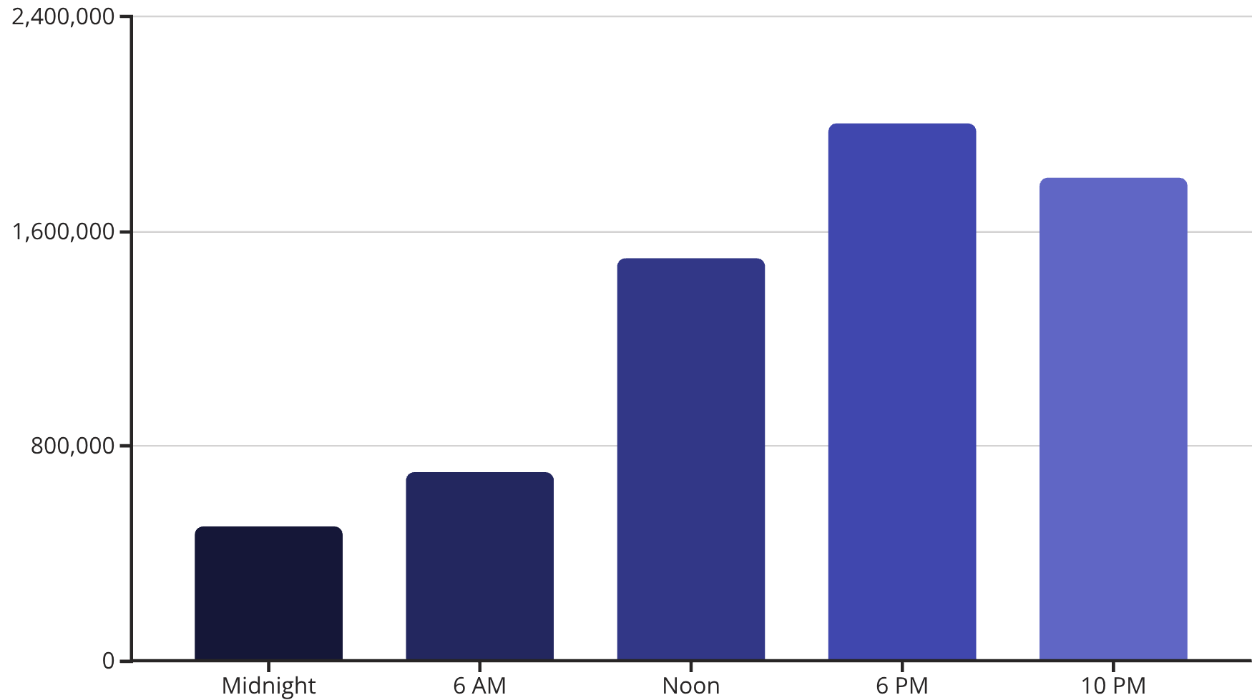
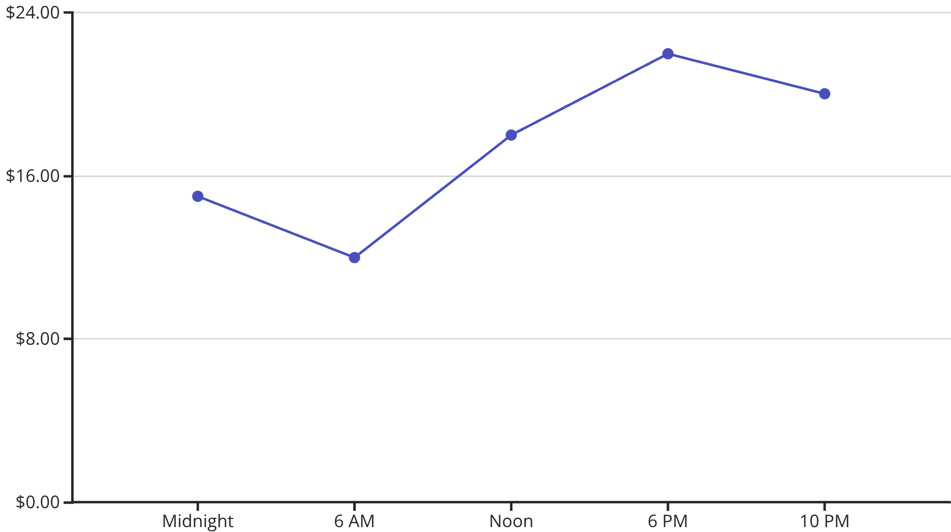
Results: Exploratory Analysis
Initial exploratory data analysis reveals key patterns in NYC taxi trip behavior.
6 PM
Friday
1.23M
7.06
Trips Peak
Weekday Peak
Top Location (ID 161)
Avg Trip Distance
Approximately 2 million trips recorded.
Highest activity with 4.4 million trips.
Most frequent pickup location.
Miles per trip.
$17.98
Avg Fare
Average cost per trip.
Figure 2: Trip Distribution by Hour of Day, showing the peak at 6 PM.
Figure 3: Average Fare by Hour, indicating higher fares during peak evening hours.

Slide 12

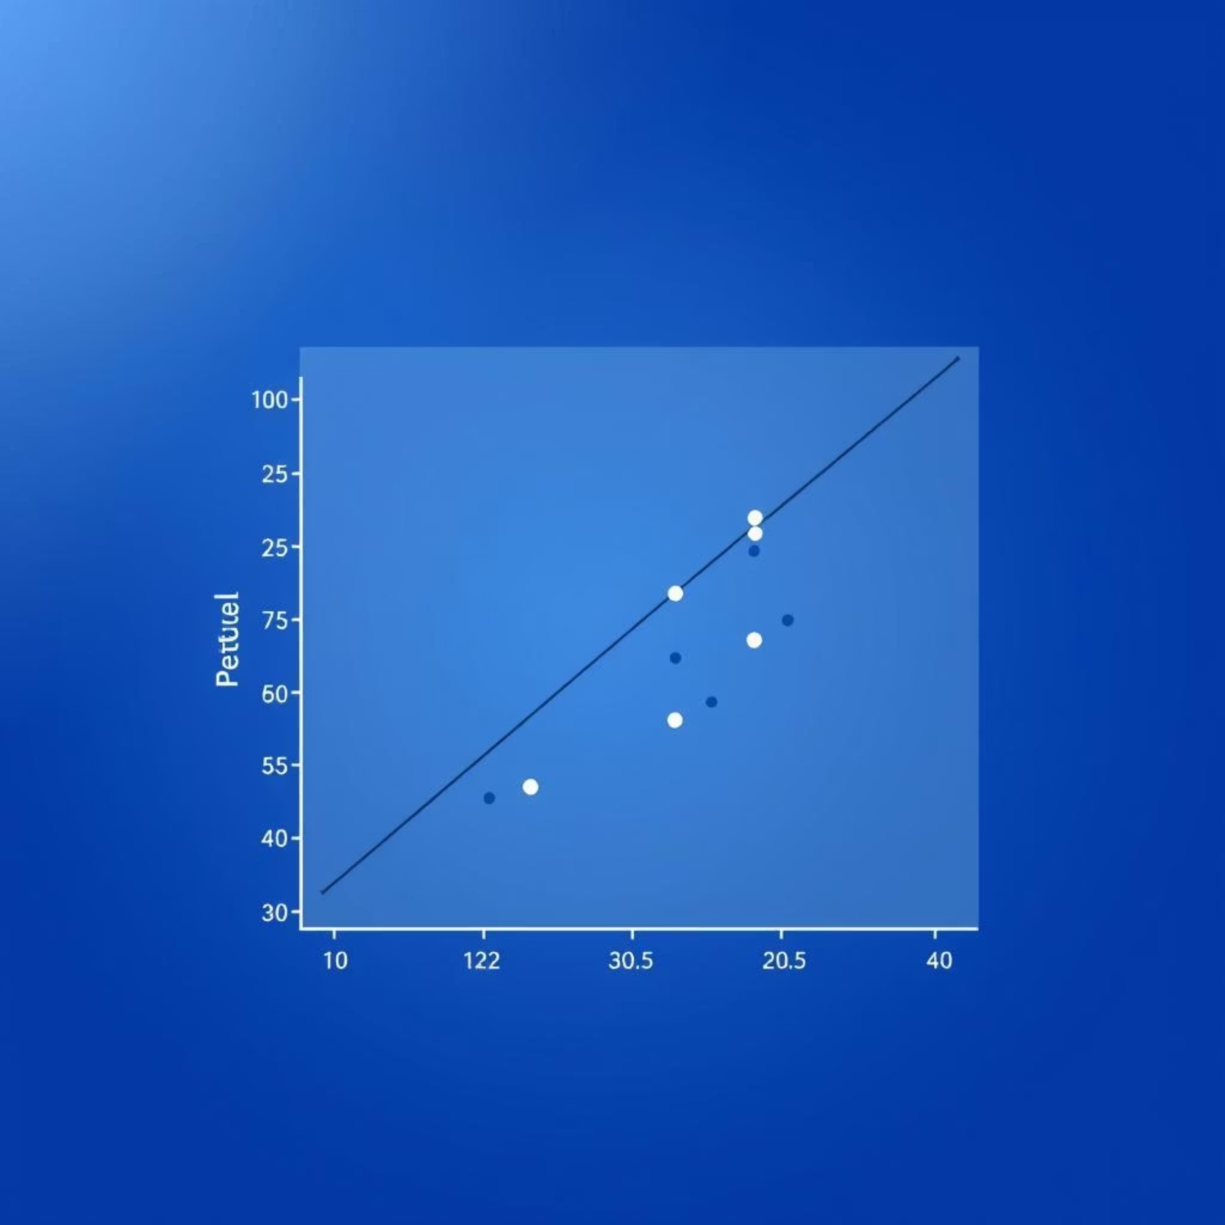
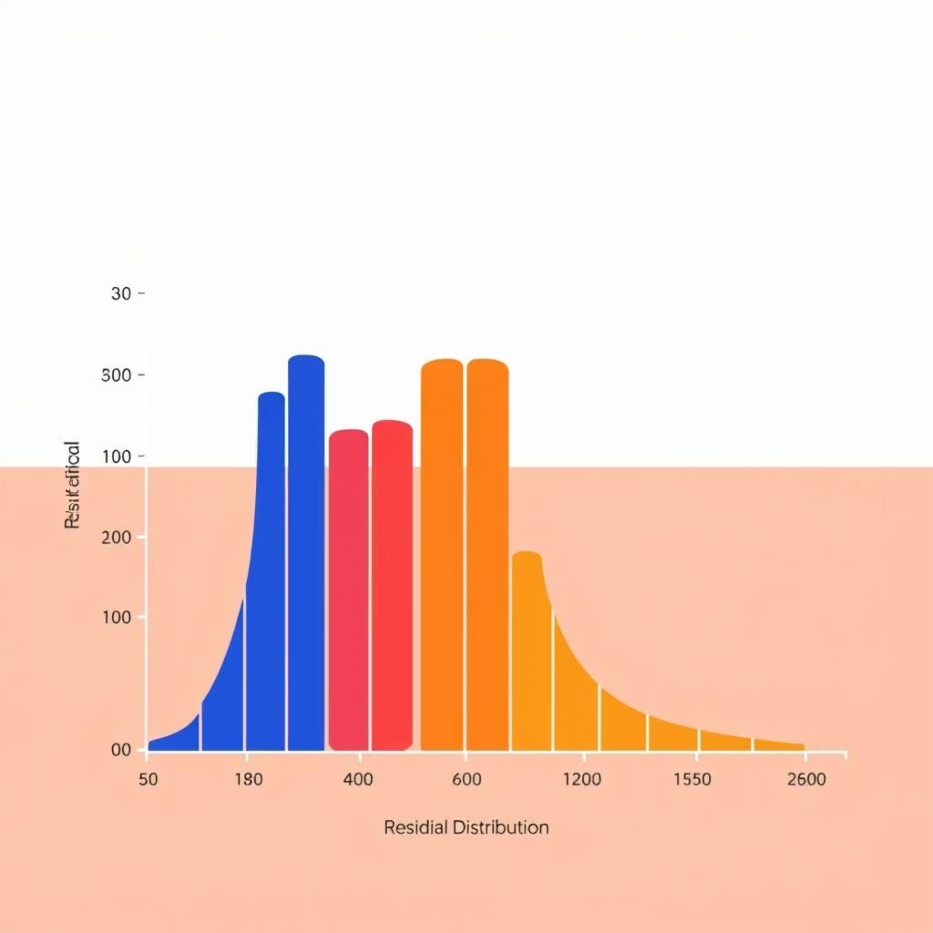
Results: Machine Learning
A regression model was developed to predict trip characteristics, yielding the following performance metrics:
752.99
557.51
0.105
RMSE
MAE
R²
Root Mean Squared Error
Mean Absolute Error
Coefficient of Determination (scope for feature engineering)
Insights: The model successfully captures general trends in the data, but its accuracy is currently limited. This suggests significant opportunities for improvement through advanced feature engineering
and potentially more complex model architectures.

Slide 13



Impact & Conclusion
Real-time Analytics
Scalability
Smart City Solution
Detect demand peaks, forecast trip volumes, identify mobility patterns.
Distributed Hadoop-Spark architecture ensures real-time processing.
Practical enabler for Computing 4.0 in urban mobility.
Future enhancements include real-time streaming, dashboard visualization, and advanced models for intelligent urban mobility management.

Slide 14

Thank You
For more information, please refer to the full paper and references.

